Slide 1
Widescreen Test Pattern (16:9)
Aspect Ratio Test
(Should appear circular)
4x3
16x9

Slide 2



Slide 3
Subdivisions of Theology
Angelology
© Copyright Prof. Rev. Dr. Harald Hesse: For the copyrights all that are in the course can use these Notes freely personal. Nevertheless, it is not permitted to pass them onto others, unless when you work over it and complete what is important for you - and put your own name on it because, you need to stand for your own believes.
You have to insert a similar copyright note on your work and put a reference to the base of source which in this case is me

Slide 4
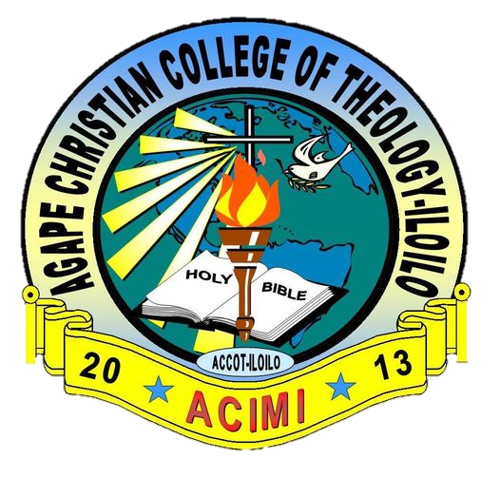


Slide 5


Slide 6
Angelology
Scripture research Major Subject of Systematic Theology

Slide 7


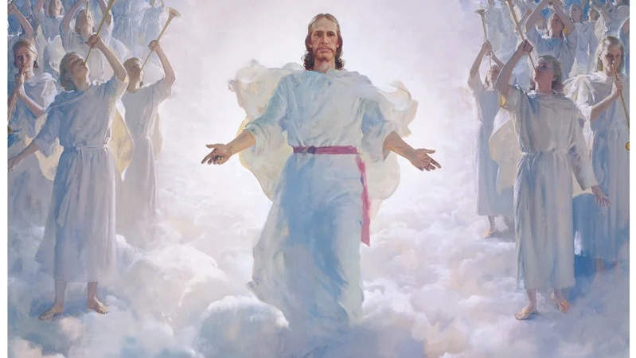
Angelology
מַלְאַךְ

Slide 8
angelology
The study of angels or the doctrine of angelology is one of the ten major categories of theology developed in many systematic theological works. The tendency, however, has been to neglect it.
So, writes Charles C. Ryrie

Slide 9
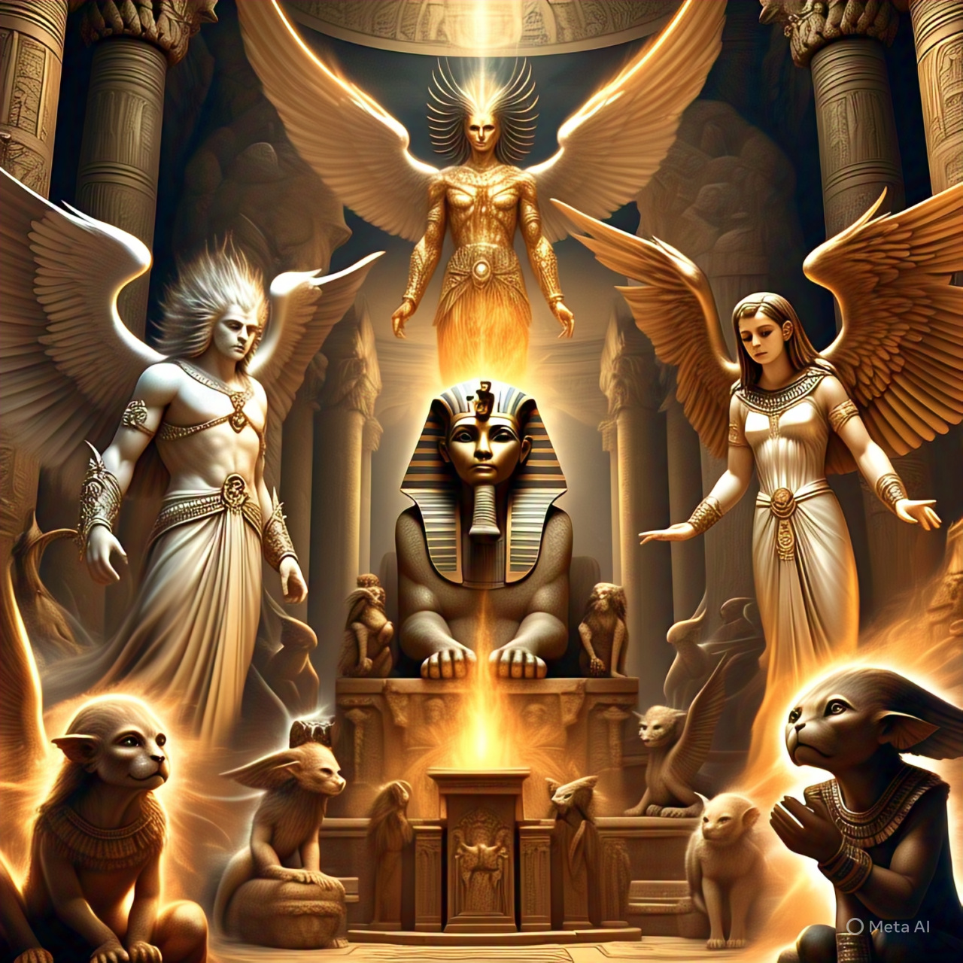
Intro
Imagine a universe teeming with life, not just the life we know on earth, but realms filled with beings beyond our wildest dreams. The fact that God has created different realms of personal beings other than mankind is a thrilling revelation, one that expands our understanding of the divine, His grand design, and His workings throughout the cosmos.

Slide 10
Intro
Picture this: Even though humanity is the very best of that what God made still it is not the pinnacle of creation. Just as the gap between humans and the lower forms of life is bridged by a myriad of creatures, so too might there be beings of immense intelligence and power that exist between us and God. The ancient mythologies of lesser deities that GOD calls gods, hint at this possibility, suggesting a hierarchy of beings superior in power to humans yet subordinate to God and like brothers to believers. This isn’t mere speculation; the Scriptures explicitly affirm the existence of such spiritual entities.

Slide 11
Intro
It would be a grave mistake to let our reliance on physical senses and materialism blind us to the reality of these power beings. Just because they are beyond our sight and touch doesn’t mean they don’t exist. The holy scriptures gives them an awesome though mystical place. The adventure of understanding these spiritual realms beckons us to broaden our horizons and embrace the full spectrum of God’s creation.

Slide 12
Universe Stars and Angels neglected
There is only a little amount of writing devoted to angelology in standard theologies. This disregard for the doctrine may simply to neglect it or may indicate rejection of this area of biblical teaching. Even Calvin was cautious in discussing this subject.
Charles C. Ryrie, Basic Theology, Victor Books, Wheaton, IL, 1987, chapter 17, electronic media.

Slide 14
They do not want you to know
And sure, I had also enmity against me for this subject, because we are going into a realm to get understanding what is the cause for events on earth. The evil creatures which are fallen, do not want us to know and sinners will go along with them not even knowing what they plan and perform.

Slide 15
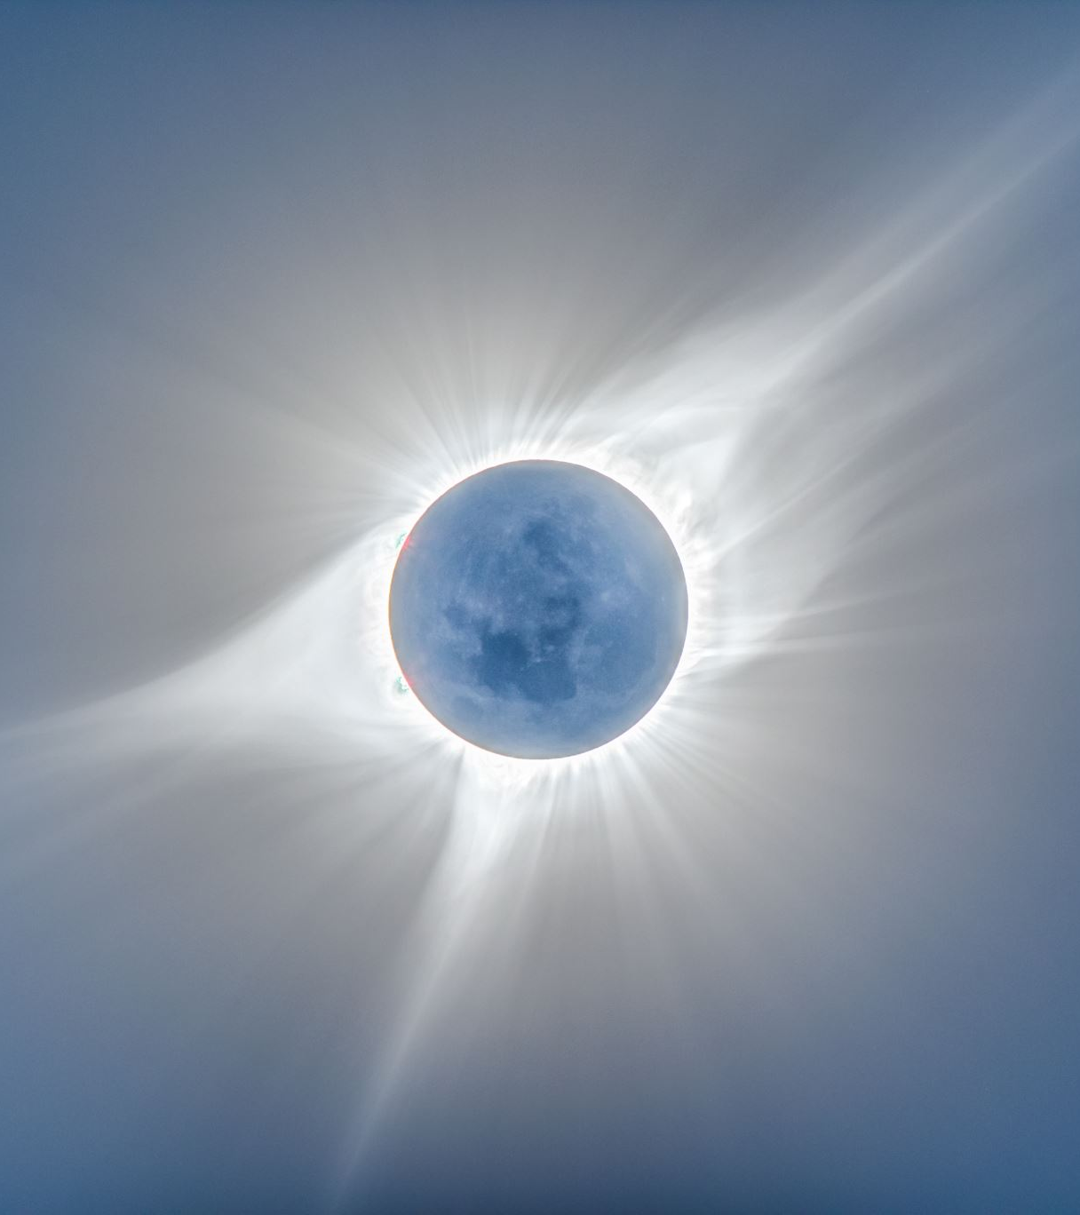
The creation of Angles
On the 4th day God created the

Slide 16
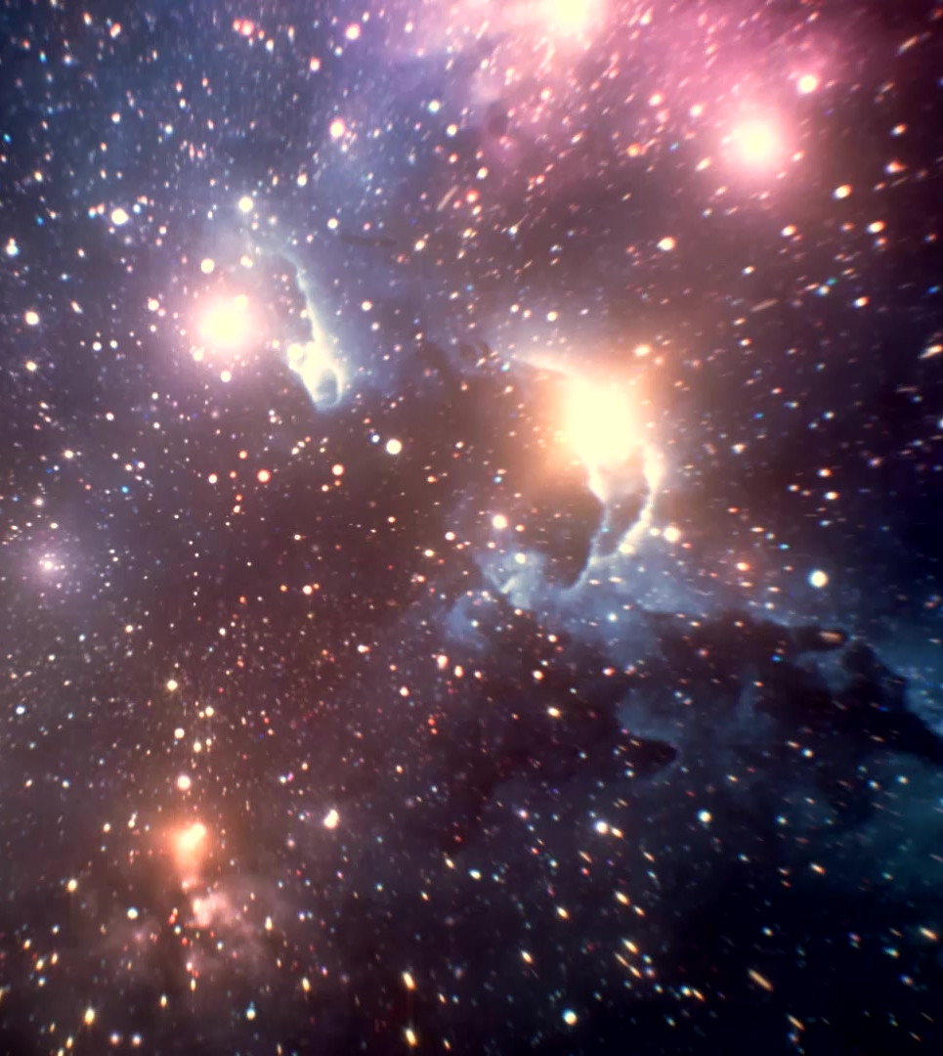
Angels set over the elements
There are Angels set over the elements of Gods creation like angels of light
2 Corinthians 11:14
And no marvel; for Satan himself is transformed into an angel of light.

Slide 17


From Adam over Job and Moses
Though the doctrine of angels is a significant theme in the Word of God, it often remains shrouded in mystery. The Bible frequently mentions angels, yet their true nature and roles are not described with the same clarity as other biblical subjects. In the oldest books of the Holy Scriptures are these Invisibles already mentioned. This enigmatic quality invites us to delve deeper, sparking a curiosity to uncover more about these celestial beings and their place in God’s grand design. What secrets might we uncover if we look beyond the surface? And where do we get more knowledge?

Slide 18

Job gives us understanding
These following references indicate that Job and his friends had an understanding of angels as divine beings who serve God, have access to His presence, and can play various roles, including being messengers and witnesses to creation. However, their knowledge also acknowledges that angels are not perfect and can be subject to error.

Slide 19
Sons of God: In Job 1:6 and Job 2:1, the term "sons of God" is used to refer to angels. These verses describe a scene where the sons of God present themselves before the Lord, and Satan also comes among them. This indicates that angels have access to God's presence and are part of a divine council.
The Adversary: Satan, who is considered an angel, plays a significant role in the story. He is depicted as an adversary who challenges Job's righteousness, suggesting that angels can have different roles and purposes, including testing humans.

Slide 20
Messengers: In Job 4:18, Eliphaz, one of Job's friends, mentions that God does not trust His servants and charges His angels with error. This implies that angels are seen as messengers or servants of God, but they are not infallible.
Witnesses to Creation: In Job 38:7, God speaks of the morning stars singing together and all the sons of God shouting for joy during the creation of the world. This suggests that angels were present at the creation and celebrated God's work

Slide 21
Angel of the LORD
Angel of the LORD is clearly an appearance of God himself as no one would say the Apostle Paul is serving an Angel instead of God
Acts 27:23
For there stood by me this night the angel of God, whose I am, and whom I serve,

Slide 22
Confidential messages
Jesus’s Angel appears to Jochanan as the angel of God
Revelation 1:1
The Revelation of Jesus Christ, which God gave unto him, to shew unto his servants things which must shortly come to pass; and he sent and signified it by his angel unto his servant John:
Revelation 1: 1
These are the confidential counsels (Or simply ‘Sodot’ – the Hebrew title for the Revelation) which YHWH gave to Yeshua Ha-Mashiach, to show his servants what will happen soon. And he sent them by the hand of his messenger to his servant Yochanan the witness of the word of YHWH, and the testimony of Yeshua Ha-Mashiach, of that which he saw.

Slide 23
The Angel of the Lord
The second difficulty concerns the identity of “the angel of the Lord” as it is used in the Old Testament. A careful study of the many passages using this term suggests that this is no ordinary angel, but a Theophany, or better, a Christophany, a preincarnate appearance of Yeshua. The angel is identified as God, speaks as God, and claims to exercise the prerogatives of God.

Slide 24
The Angel of the Lord
Still, in some passages He distinguishes Himself from Yahweh (Gen. 16:7-14; 21:17-18; 22:11-18; 31:11-13, Ex. 3:2; Judg. 2:1-4; 5:23; 6:11-22; 13:3-22; 2 Sam. 24:16; Zech. 1:12; 3:1; 12:8). That the Angel of the Lord is a Christophany is suggested by the fact a clear reference to “the Angel of the Lord” ceases after the incarnation.
References to an angel of the Lord in Luke 1:11; and 2:8 and Acts 5:19 lack the Greek article which would suggest an ordinary angel.

Slide 25
Sons of GOD

Slide 26
Sons of God
In their holy state, unfallen angels are called “sons of God” in the sense that they were brought into existence by the creation of God (Job 1:6; 38:7). Though they are never spoken of as created in the image of God, they are also be called “sons of God” because they possess personality like God. This term is also used in Genesis 6:2 which tells us the “sons of God” took wives from among the “daughters of men.”

Slide 27
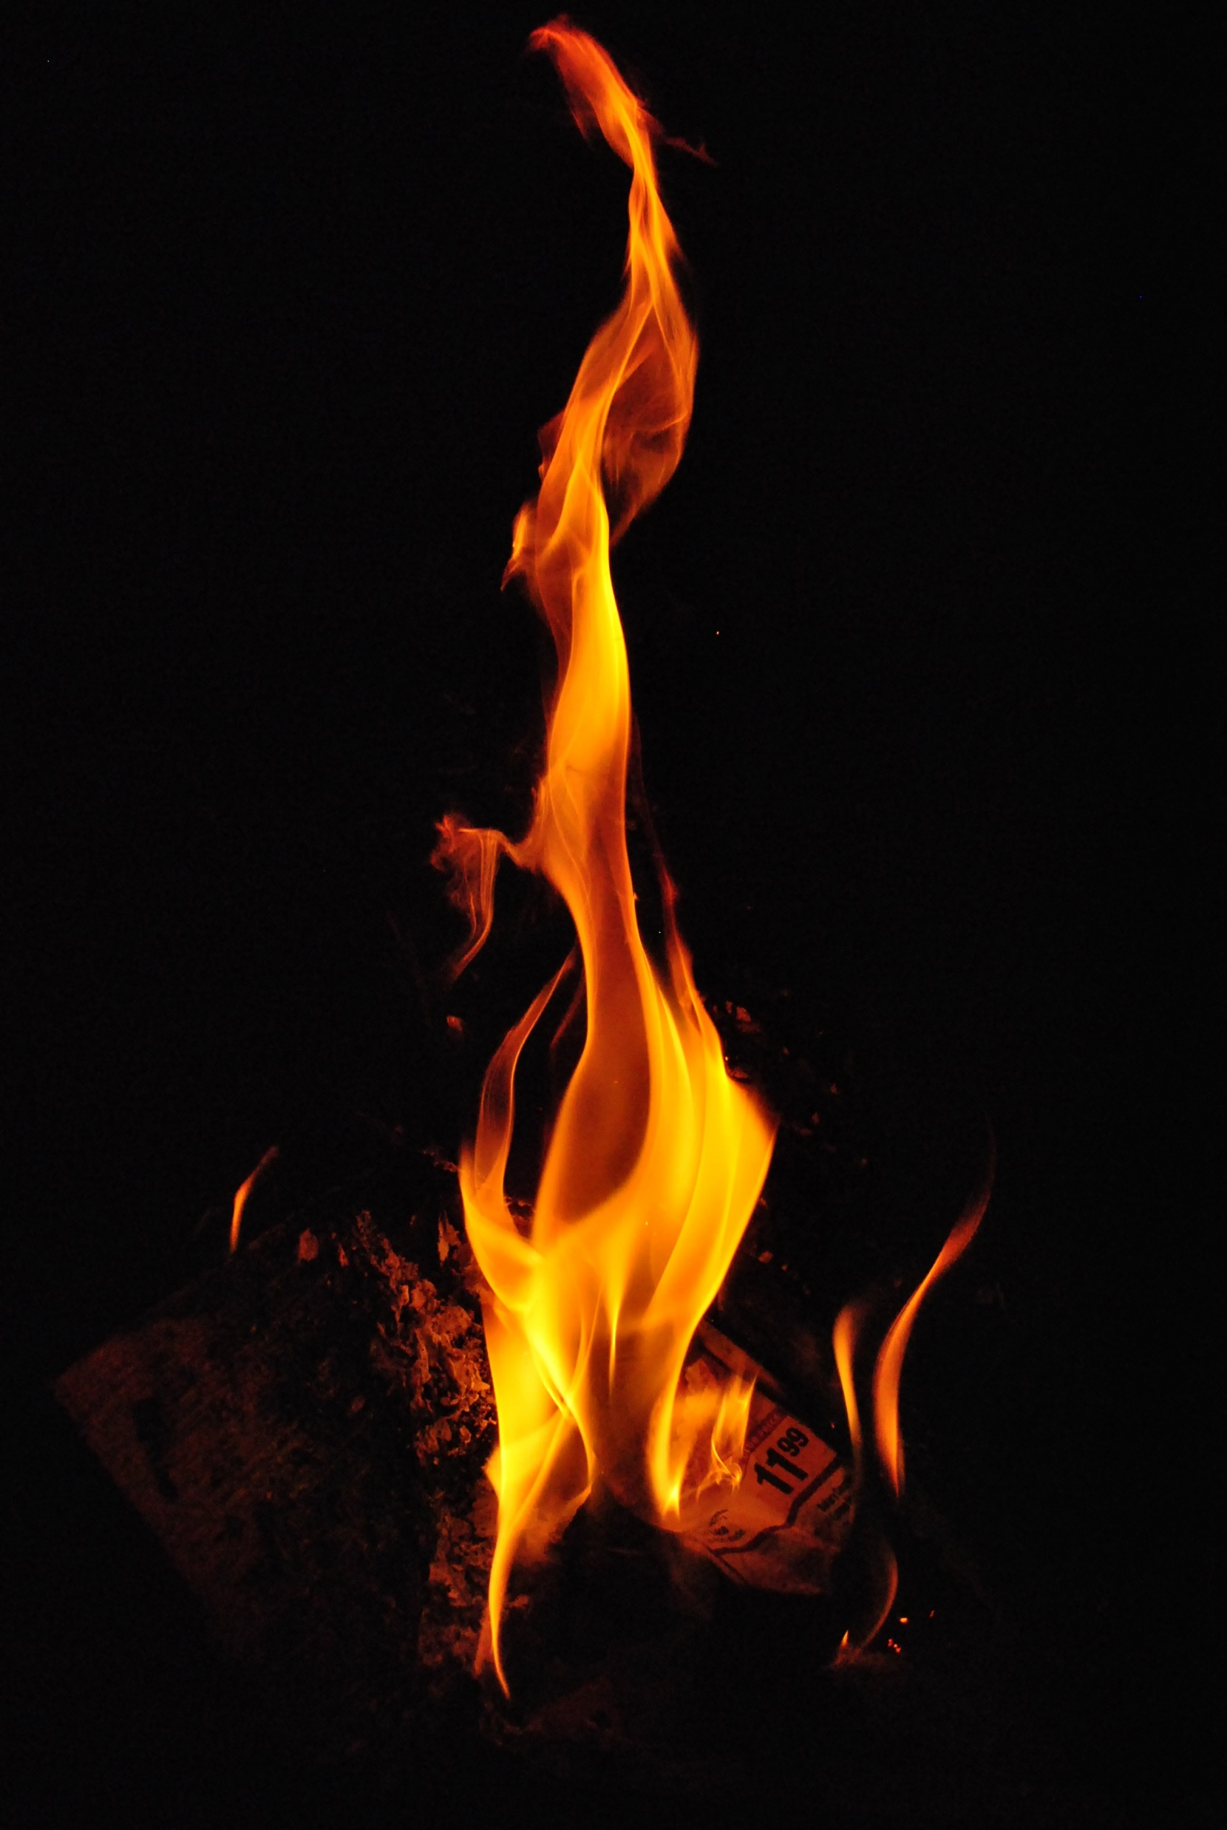
Sons of God
Though they are never spoken of as created in the image of God, they are also be called “sons of God” because they possess personality like God.
In their holy state, “unfallen angels” are called “sons of God” in the sense that they were brought into existence by the creation of God (Job 1:6; 38:7).
This term is also used in Genesis 6:2 which tells us the “sons of God” took wives from among the “daughters of men.”
This Photo by Unknown Author is licensed under CC BY-SA

Slide 28
Sons of God
Though the bible has no support for this point of view
Some scholars understand “the sons of God” of Genesis 6:2 to refer to the sons of the godly line of Seth © 1998 Biblical Studies Press http://www.bible.org 3 and the “daughters of men” to refer to the ungodly line of the Cainites.
This Photo by Unknown Author is licensed under CC BY-SA

Slide 29
Sons of God
Still others believe they refer to despots, powerful rulers. Ross writes: The incident is one of hubris, the proud overstepping of bounds. Here it applies to “the sons of God,” a lusty, powerful lot striving for fame and fertility.
They were probably powerful rulers who were controlled (indwelt) by fallen angels. It may be that fallen angels left their habitation.
We never find in the Bible that a person was possessed by an Angel only by devils / demons

Slide 30
Sons of God
Others, in keeping with the use of “sons of God” in Job 1:6, 2:1. 4:18, 38:7 , believe the term refers to fallen angels who mated with the daughters of men to produce an extremely wicked and powerful progeny that led to the extreme wickedness of Noah’s day.
This latter view find further support in
2 Peter 2:4-6 and Jude 6-7
This Photo by Unknown Author is licensed under CC BY-SA

Slide 31

Angels have a spiritual body
Angels do not dwell in other persons they have their own body

Slide 32
Angels have a planet
Deu 4:19
And lest thou lift up thine eyes unto heaven, and when thou seest the sun, and the moon, and the stars, all the host of heaven, shouldest be driven to worship them, and serve them, which the LORD thy God hath divided unto all nations under the whole heaven.

Slide 33
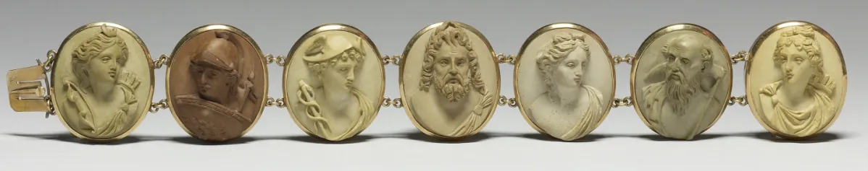
GOD made everything
Nehemiah 9:6
You, you, LORD alone; you hast made heaven, the heaven of heavens, with all their host, the earth, and all that therein, the seas, and all that therein, and thou preserves them all; and the host of heaven worships you.

Slide 34
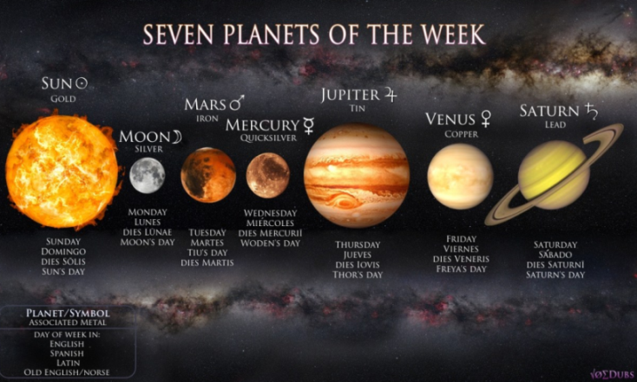

Origin of the Days names

Slide 35
Excurse
Greek
Mythology

Slide 36
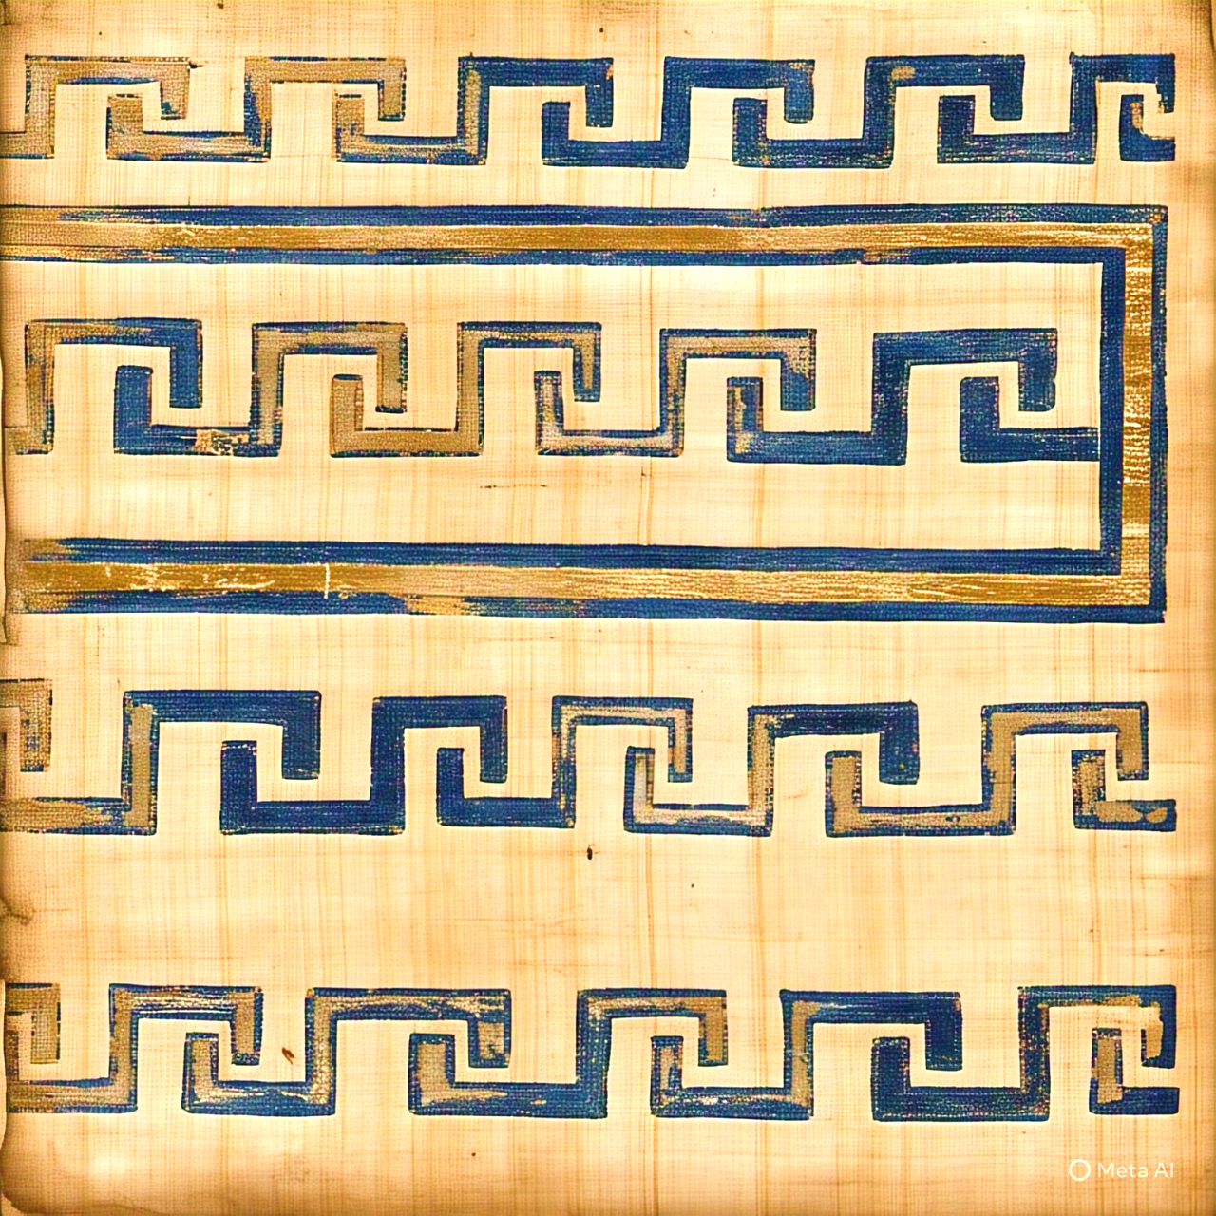
Greek Mythology
Primordial gods:
Gaia Tartarus Erebus Nyx
Curea Uranus Pontus Aether Hemera Thalassa
Titans
Cyclopes Hecatoncheires Sphinx Hydra Orthrus Cerberus Colchian Dragon Chimera Gigantes Erinyeas Meliae Iris Harpies Sirens Scylla Gorgons Graeae

Slide 37
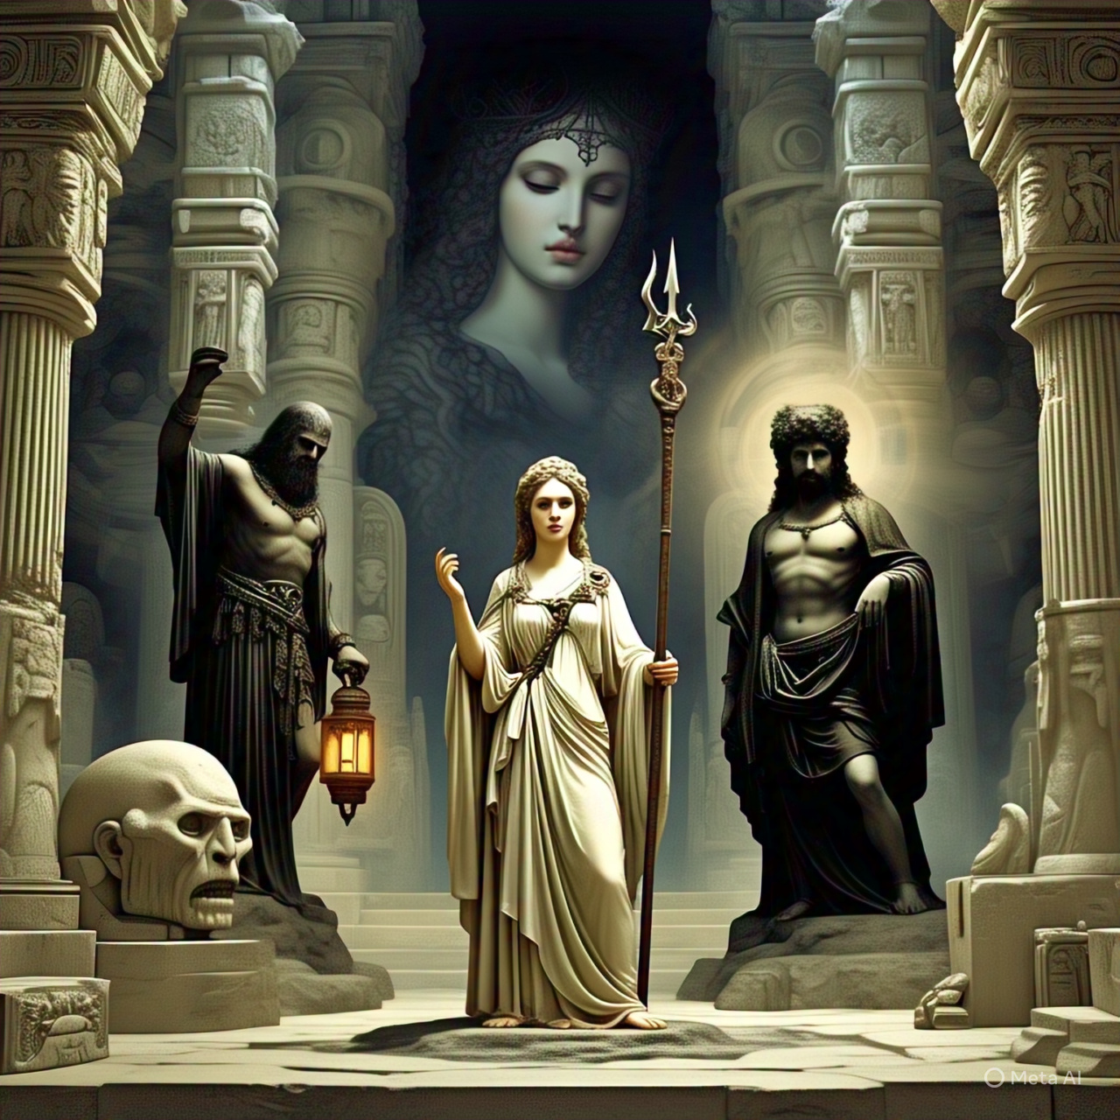
First The VOID then
The Beginning of Greek Mythology
Cronos and Ananke
Time and destiny
Gaia: mother earth
Tartarus: bottomless pit
Erebus: Darkness
Nyx: Night

Slide 38
Creation of GAIA
Curea: Mountains
Uranus: Sky / Heavens
Pontus: Sea Thalassa & Ceto : Sea Goddess
Phorcys & Thaumus: Sea Gods
Aether: upper Sky
Hemera: Day
Charon Ferryman to the underworld.
Doom- Death- Sleep- Dream-Spirits

Slide 39
Titans
Cyclopes : one eyed monsters
Hecatoncheires : Sky
Sphinx: Sea Hydra: Sea Goddess Orthrus:
Two headed Dog Cerberus : Three headed Dog
Colchian Dragon Chimera Gigantes Erinyeas Meliae Iris Harpies Sirens Scylla Gorgons Graeae

Slide 40
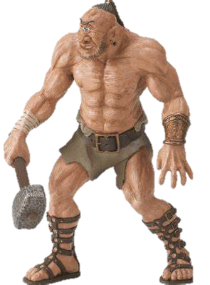
Cyclop

Slide 41
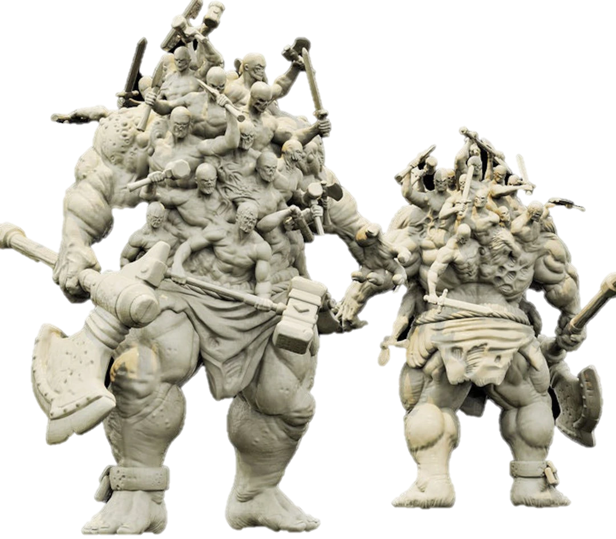
Hecatoncheires

Slide 42
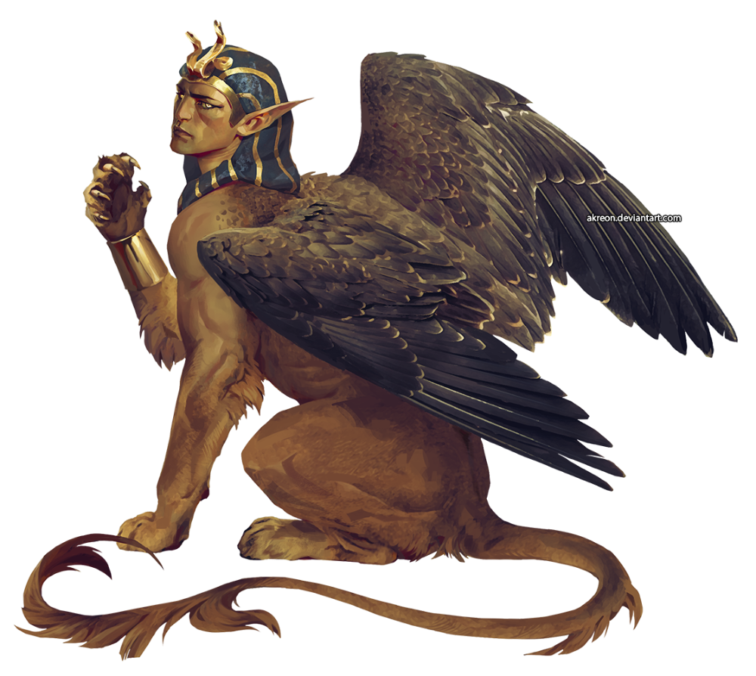
Sphinx

Slide 43
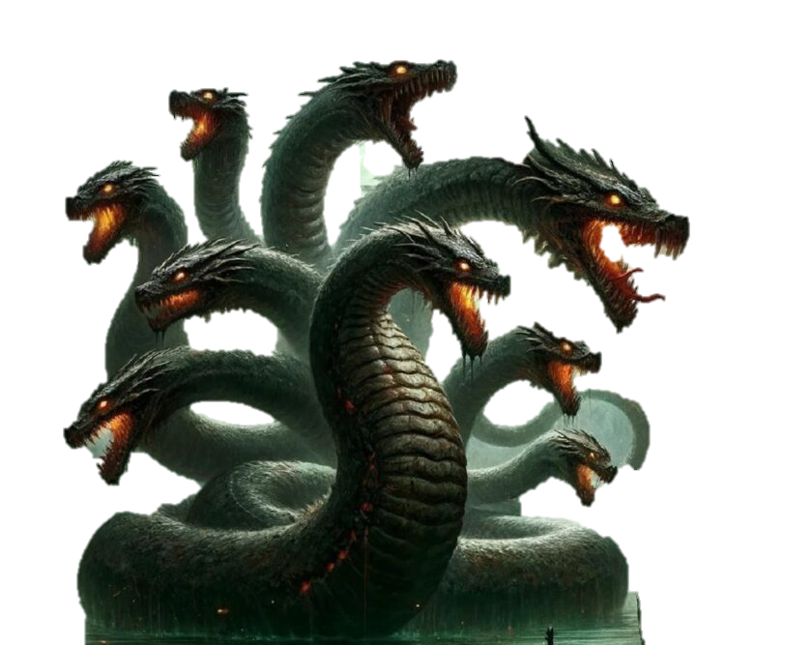
Hydra

Slide 44
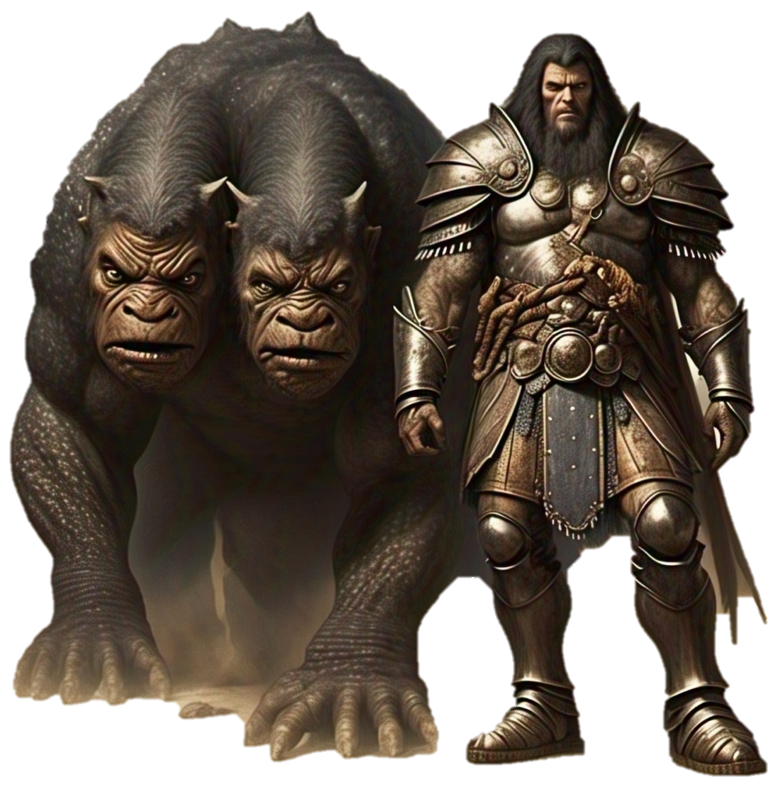
Orthrus

Slide 45
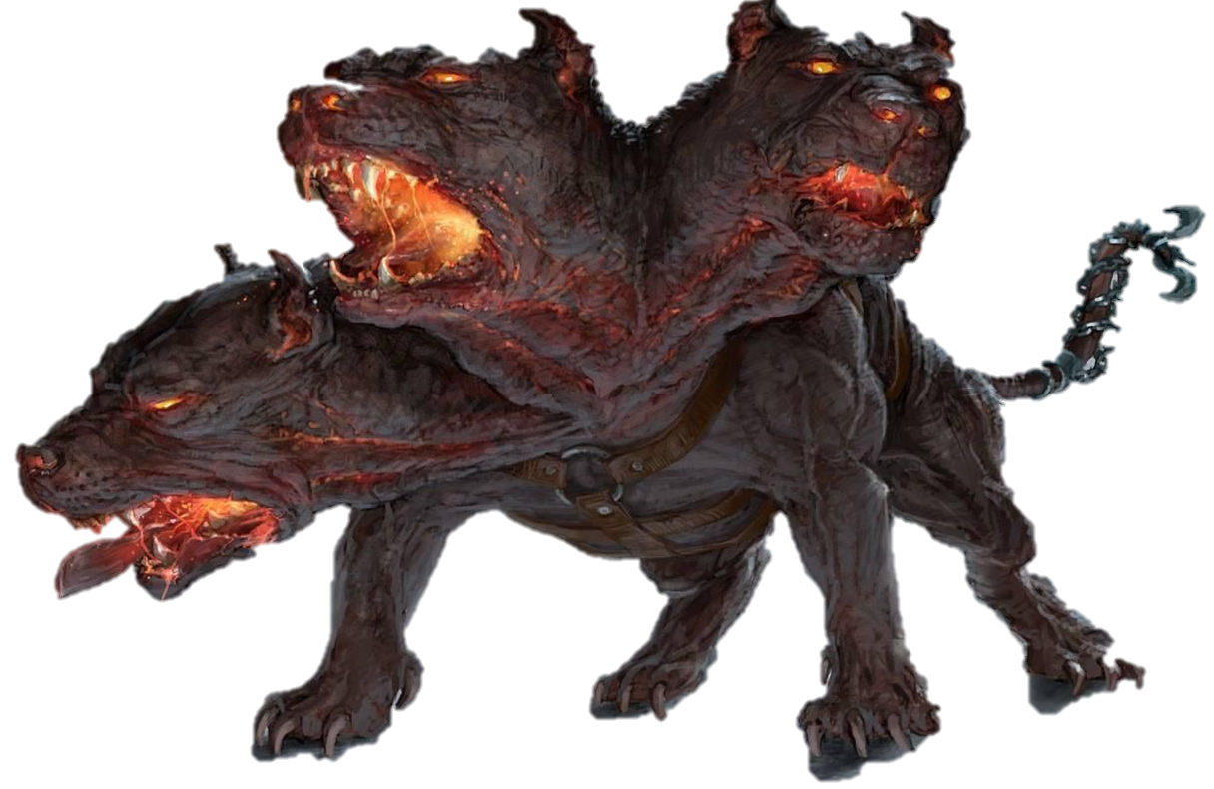
Cerberus

Slide 46
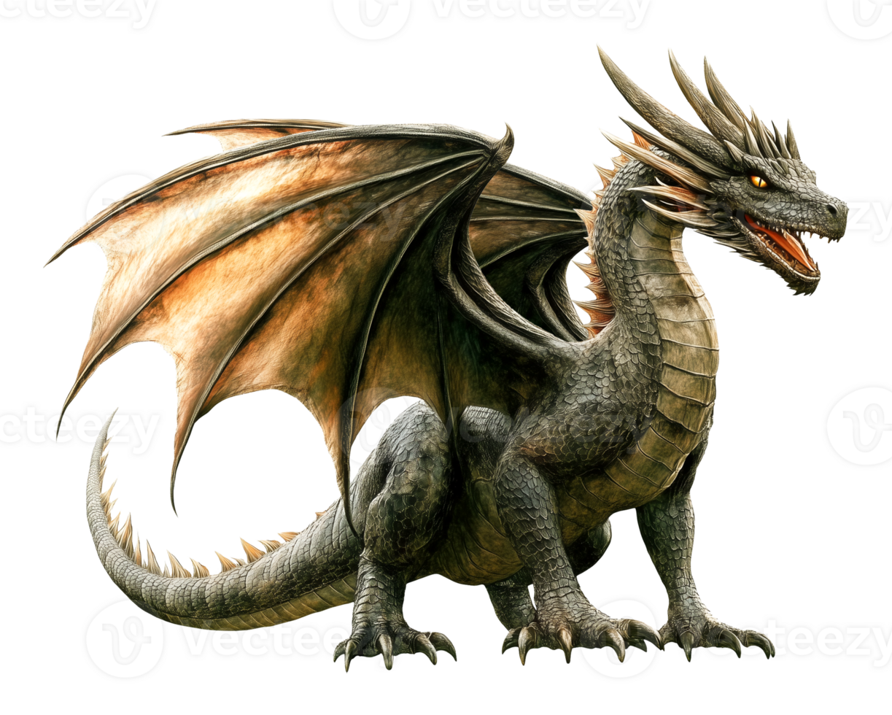
Colchian Dragon

Slide 47
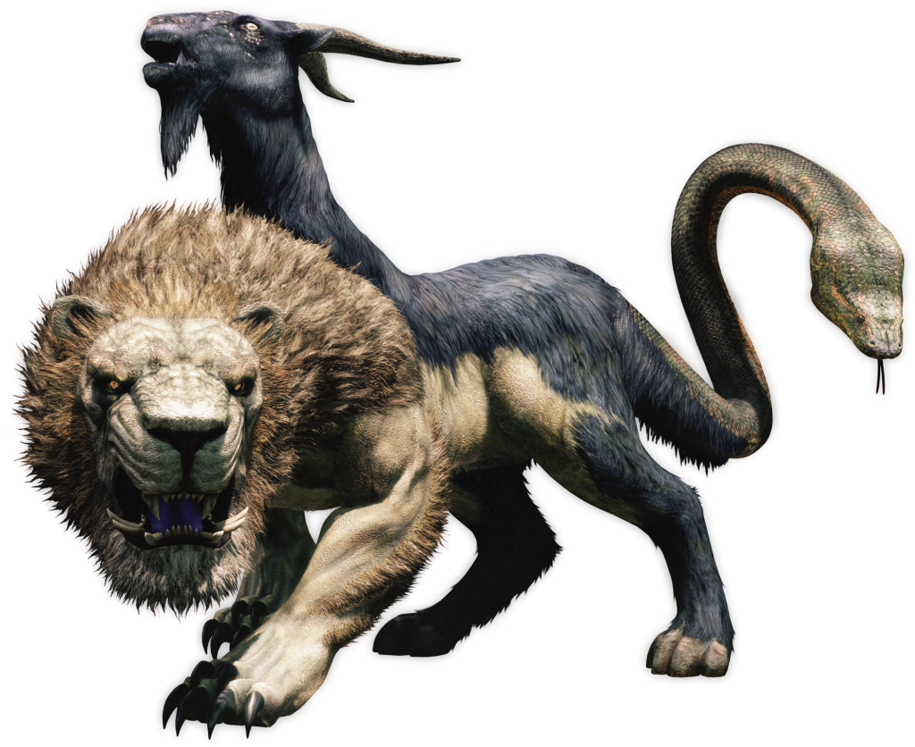
Chimera

Slide 48
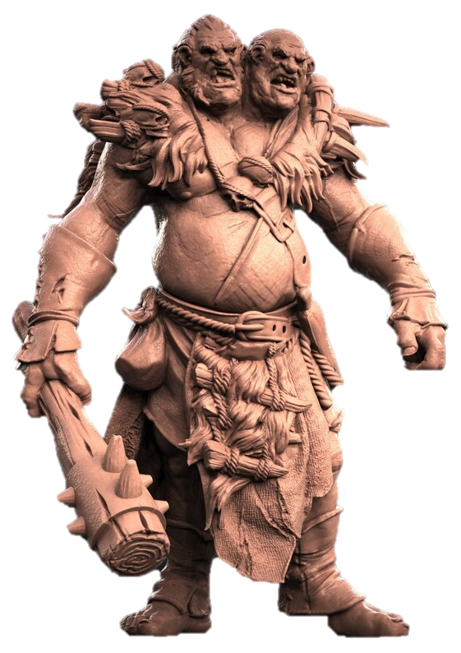
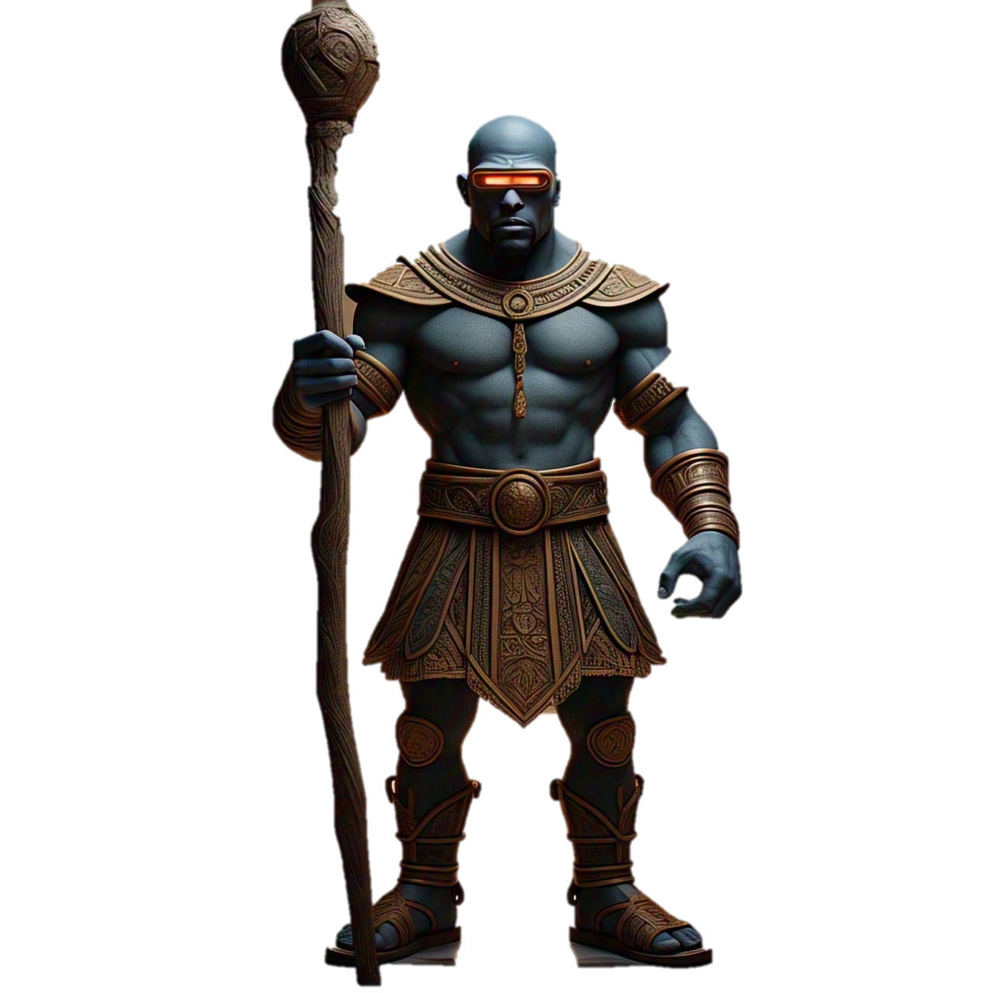
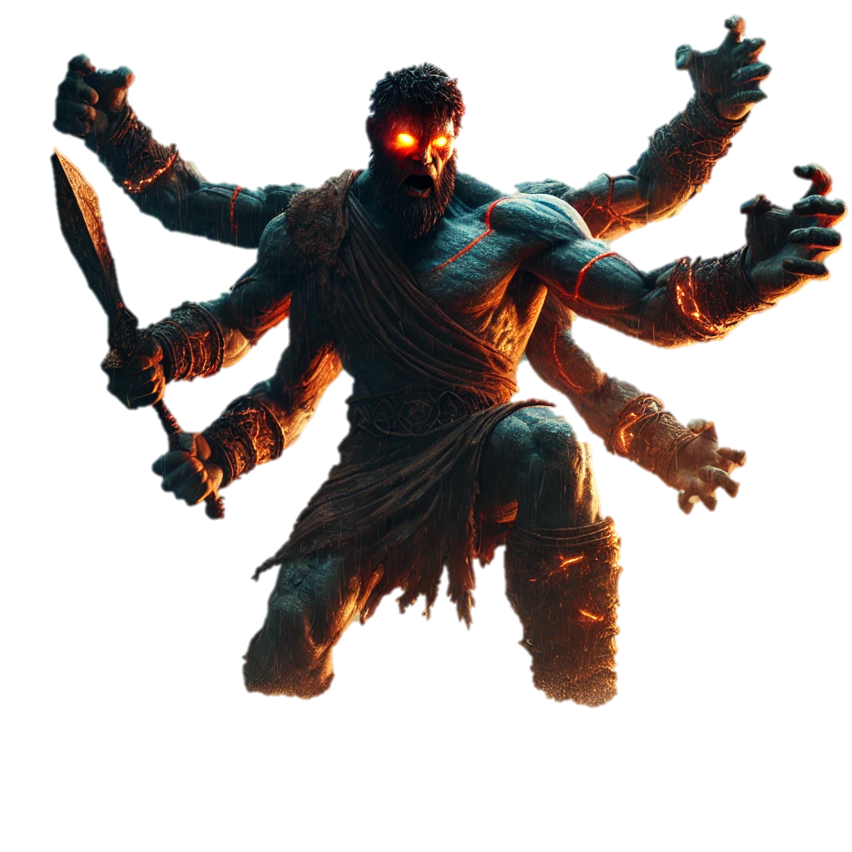
Gigantes

Slide 49
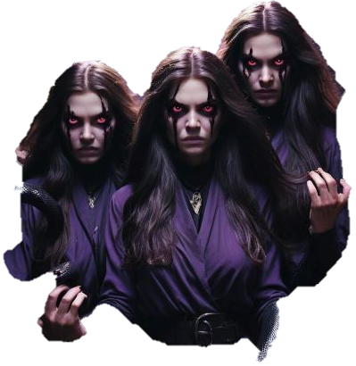
Erinyeas the three furies
Goddesses of vengeane

Slide 50
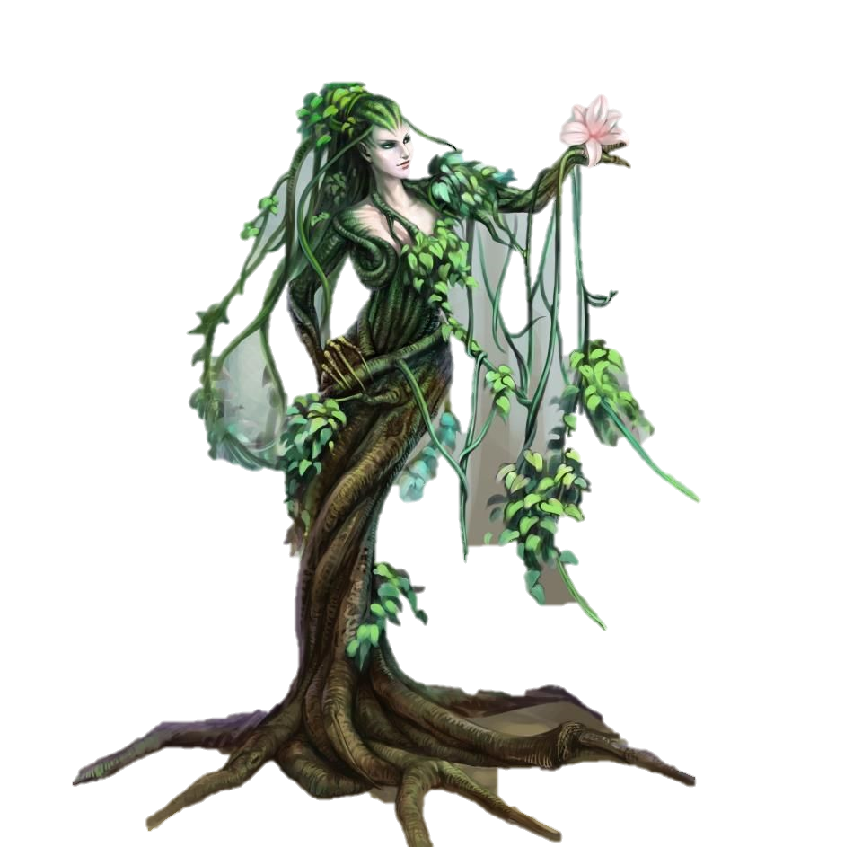
Meliae
The nymph ash trees that walk

Slide 51
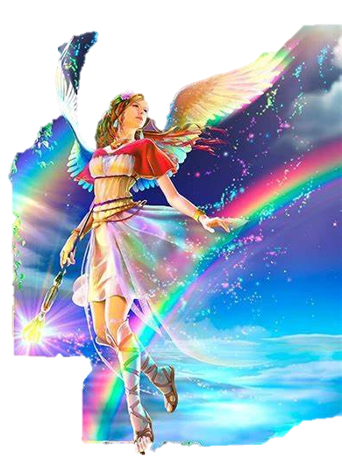
iRIS the rainbow Goddess

Slide 52
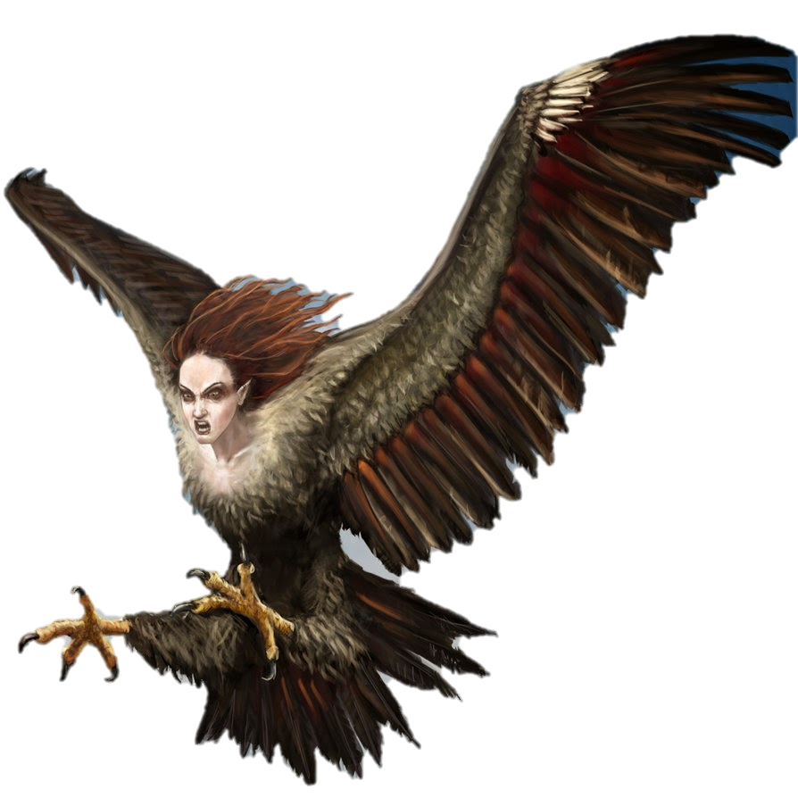
Harpies evil spirits that steal food

Slide 53

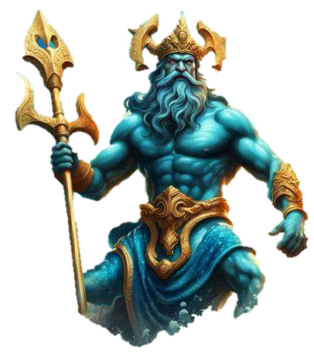
SirenS

Slide 54

Scylla the sea Monster

Slide 55
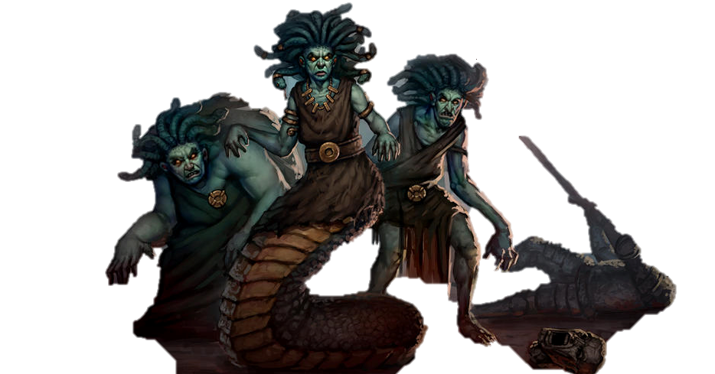
The
Gorgons
MedusA with her evil Sisters

Slide 56
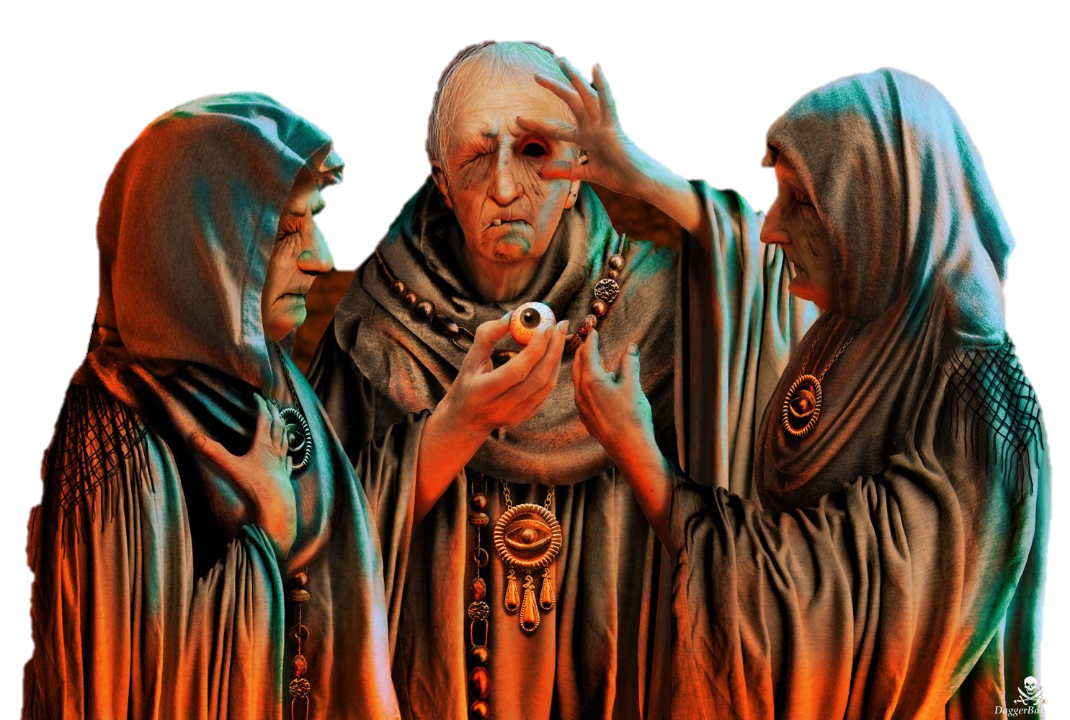
Graeae Sisters

Slide 57
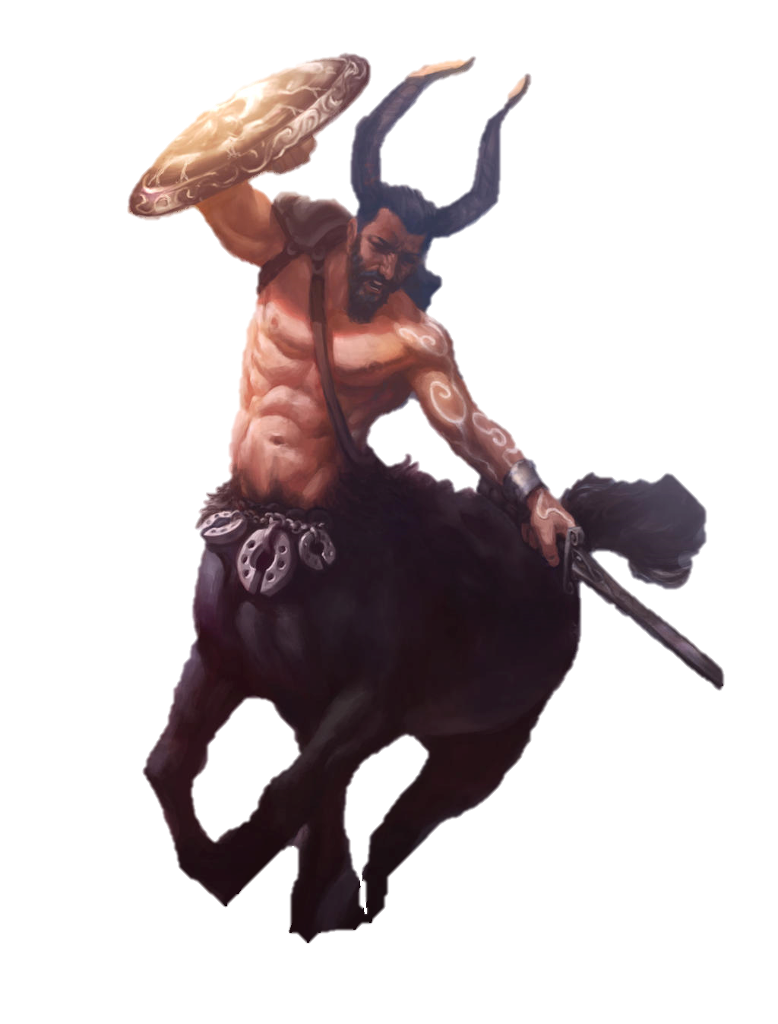
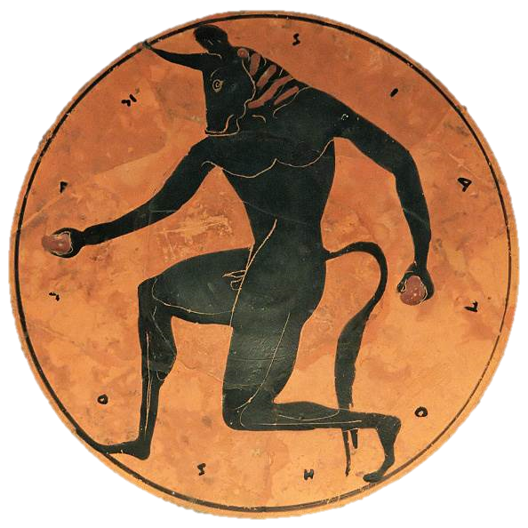
Minotaur & Centaur

Slide 58
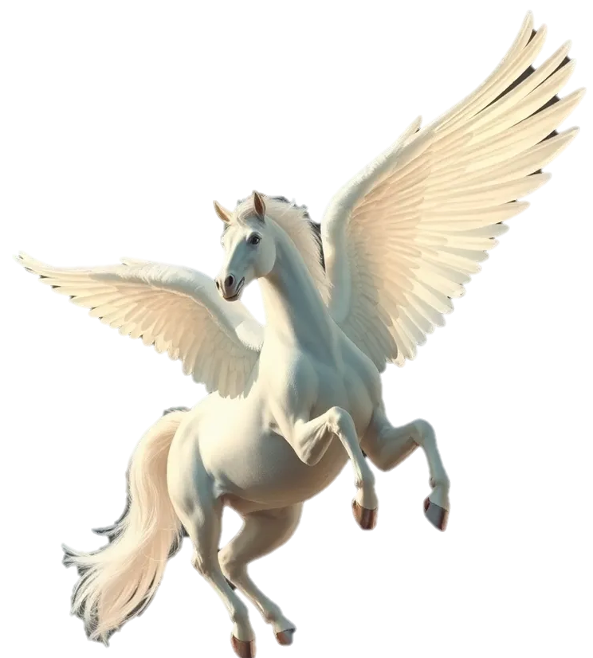
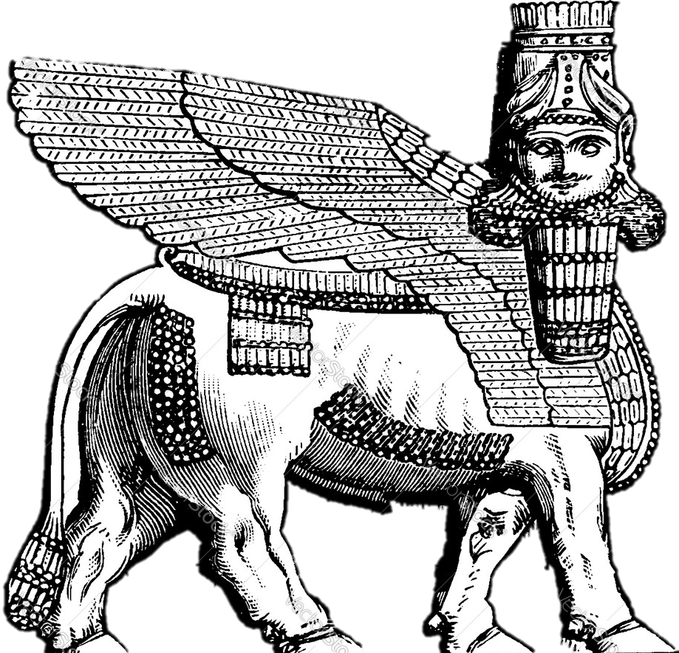
Many more

Slide 59
Cronus Rhea / Cybele
Olympians
Zeus Hera Poseidon Demeter Hades Hestia
Athena Hebe Hephaistos Ares Aphrodite Adonis Hermes Apollo Artemis

Slide 60
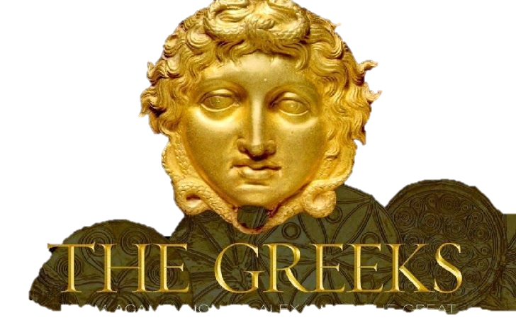
END of Excurse
Greek
Mythology

Slide 61
The complete nonsense comes from modern Astrology
Michael, Archangel of the Sun → Apollo / Ήλιος
Gabriel, Archangel of the Moon → Diana / Άρτεμις
Raphael, Archangel of Mercury → Ερμής
Hanael, Archangel of Venus → Αφροδίτη
Camael, Archangel of Mars → Άρης
Zadkiel, Archangel of Jupiter → Ζεύς
Cassiel, Archangel of Saturn → Κρόνος

Slide 62
Stay away when it says
Angel Prayers for Inner Peace and Comfort Before Sleep
Unlocking the Power of the Archangel Prayer
The Healing Power of Archangel
Key to Manifesting Miracles
Connecting with Your Guardian

Slide 63
Angels get gatgets
Angels have certain tasks and are caretakers of events and objects as also seen in the revelation with censors, trumpets, bowls and the seal of the living God and other tools and keys

Slide 64
You can hear the Angels fly
They make sound when they fly
Revelation 8:13
And I beheld, and heard an angel flying through the midst of heaven, saying with a loud voice, Woe, woe, woe, to the inhabiters of the earth by reason of the other voices of the trumpet of the three angels, which are yet to sound!

Slide 65
Gospel in the tribulation
Ele HaSodod 9: 1 Then the fifth messenger blew, and I saw that a star fell onto the earth from the heavens, and to him the key of the Deep was given.
In the tribulation the gospel is given to angels
Revelation 14:6 And I saw another angel fly in the midst of heaven, having the everlasting gospel to preach unto them that dwell on the earth, and to every nation, and kindred, and tongue, and people.

Slide 66
God gives them tools
They have keys from God
Revelation 20:1 And I saw an angel come down from heaven, having the key of the bottomless pit and a great chain in his hand.

Slide 67
Angels
They harvest the earth and are the companions and brothers of the saints.
They punish the wicked, the beast, the religion and economics of Babylon and

Slide 68
the greatest power in the universe is the love of God
Romans 8:38-39 For I am persuaded, that neither death, nor life, nor angels, nor principalities, nor powers, nor things present, nor things to come, 39 Nor height, nor depth, nor any other creature, shall be able to separate us from the love of God, which is in Christ Jesus our Lord.
Ephesians 3:10 To the intent that now unto the principalities and powers in heavenly places might be known by the church the manifold wisdom of God,
Ephesians 6:12 For we wrestle not against flesh and blood, but against principalities, against powers, against the rulers of the darkness of this world, against spiritual wickedness in high places.

Slide 69
Angels are created for Yeshua
Colossians 1:16
For by him were all things created, that are in heaven, and that are in earth, visible and invisible, whether they be thrones, or dominions, or principalities, or powers: all things were created by him, and for him:

Slide 70
The place of Angels
The realm of Angels is in the invisible heavens though they have access to the physical world. Since the heavens with their universe is very spacious so. Is the number of Angels innumerable.
Hebrews 12:22

Slide 71
We should not worship angels
Colossians 2:18
Let no man beguile you of your reward in a voluntary humility and worshipping of angels, intruding into those things which he hath not seen, vainly puffed up by his fleshly mind.

Slide 72
Like we Angels are organized
Titus 3:1
Put them in mind to be subject to principalities and powers, to obey magistrates, to be ready to every good work,…
1 Timothy 3:6 about bishops and deacons
Not a novice, lest being lifted up with pride he fall into the condemnation of the devil.

Slide 73
Organization of Angels
The closer to GOD the more power
The closer to GOD the more in eternity
The closer to GOD the more knowledge
The closer to GOD the more important
The closer to GOD the more beauty
The closer to GOD the more praise

Slide 74
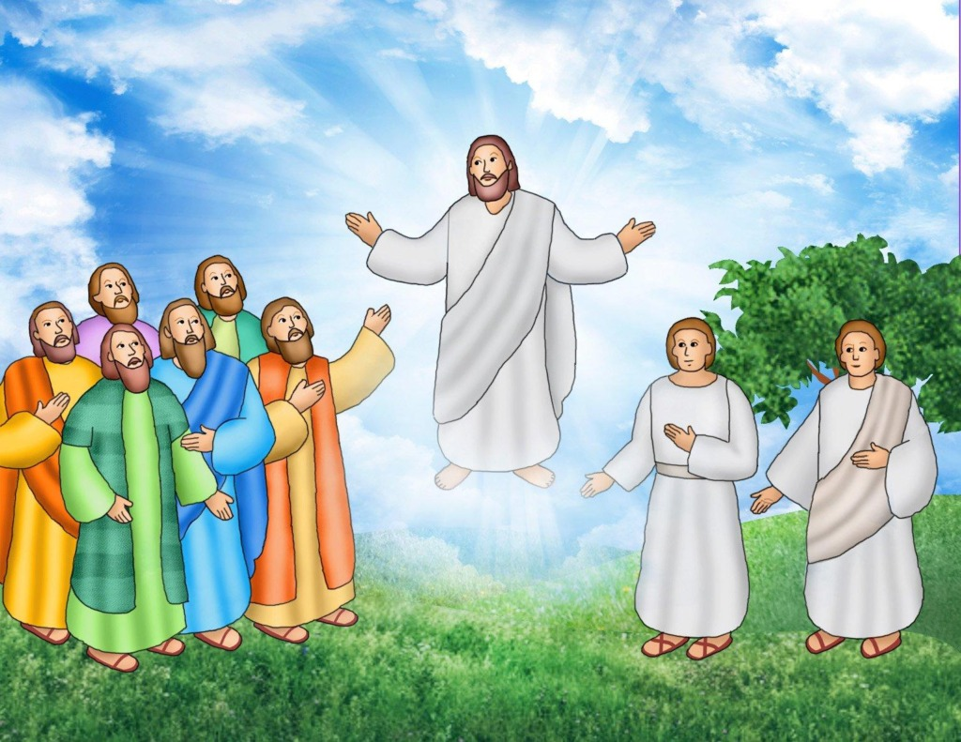
When angels are seen
Angels are mainly
seen in bright clothing
without wings

Slide 75
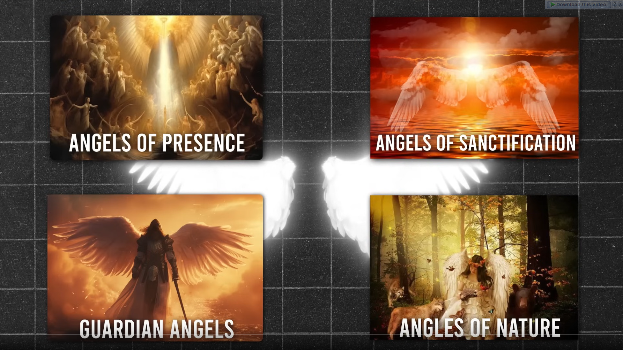

Slide 76
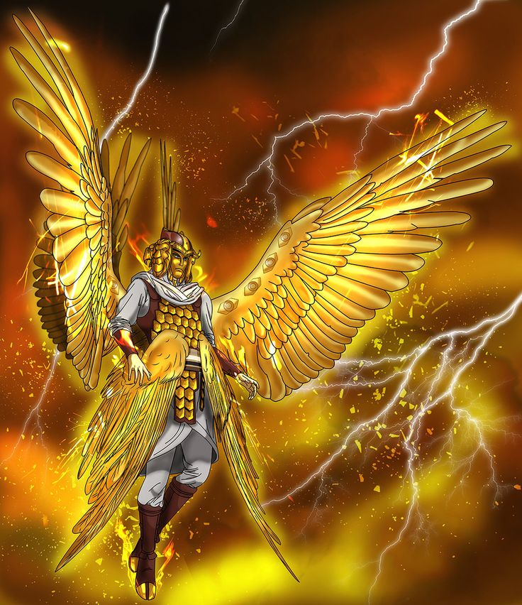
Type of Angels
Archangels
Cherub
Seraph
Living creatures around the throne of GOD
appeared like a lion, an ox, a man, and an eagle (Ezekiel 1:5–14, Revelation 4:6–8)

Slide 77
Angels support the Gospel
Acts 10:32 Send therefore to Joppa, and call hither Simon, whose surname is Peter; he is lodged in the house of one Simon a tanner by the sea side: who, when he cometh, shall speak unto thee.
Acts 10:38 How God anointed Jesus of Nazareth with the Holy Ghost and with power: who went about doing good, and healing all that were oppressed of the devil; for God was with him.

Slide 78
Some are guardians
Acts12:12-15
Acts 12:12 And when he had considered , he came to the house of Mary the mother of John, whose surname was Mark; where many were gathered together praying. 13 And as Peter knocked at the door of the gate, a damsel came to hearken, named Rhoda. 14 And when she knew Peter's voice, she opened not the gate for gladness, but ran in, and told how Peter stood before the gate. 15 And they said unto her, Thou art mad. But she constantly affirmed that it was even so. Then said they, It is his angel.

Slide 79
guardians
Matthew 18:10 Take heed that ye despise not one of these little ones; for I say unto you, That in heaven their angels do always behold the face of my Father which is in heaven.
Mat 19:14 But Jesus said, Suffer little children, and forbid them not, to come unto me: for of such is the kingdom of heaven.

Slide 80
Angels are not omniscient
Daniel 10:11b -14
…thy words were heard, and I am come for thy words. 13 But the prince of the kingdom of Persia withstood me one and twenty days: but, lo, Michael, one of the chief princes, came to help me; and I remained there with the kings of Persia. 14 Now I am come to make thee understand…

Slide 81
Angel are extremely powerful
Even though Angels are bound to time when on earth still they demonstrate a precision and an unleash of power over the enemies of the LORD in an absolute vehement action.

Slide 82
Angels are a part in GODs plan
They are the daring couriers of GOD, racing across lands to deliver his messages to the people (Luke 1:11–19, Acts 8:26, 10:3–8, 22, 27:23–24).
They execute GOD’s harsh decrees, unleashing plagues upon the land. (2 Samuel 24:16–17), smiting the leaders of the Assyrian army (2 Chronicles 32:21), striking King Herod dead because he denied to give glory to GOD (Acts 12:23), or pouring out the wrath of GOD in bowls down to the earth (Revelation 16:1).

Slide 83
Angels are a part in GODs plan
When Christ come back, armies of angels will accompany the darling of Heaven their King (Matthew 16:27, Luke 9:26, 2 Thessalonians 1:7).
They roam the earth as GOD’s trusted emissaries, ever watchful and ready to act (Zechariah 1:10–11).
They wage relentless war against enemy and devil forces, striking fear into their hearts (Daniel 10:13; Revelation 12:7–8).

Slide 84
Angels are a part in GODs plan
John records that “an angel “(anonymous so that the devil cannot take revenge) grabbed the dragon, that old serpent, who is the Devil and Satan, and bound him for a thousand years, and threw him into the pit . . .” (Revelation 20:1–3).
When Christ returns, an archangel will come with him to proclaim his coming
(1Thessalonians 4:16, see also Revelation 18:1–2, 21, 19:17–18, and other passages).

Slide 85
Angel do the will of God
As Gods will is done in heaven so,
the angels become an example.

Slide 86

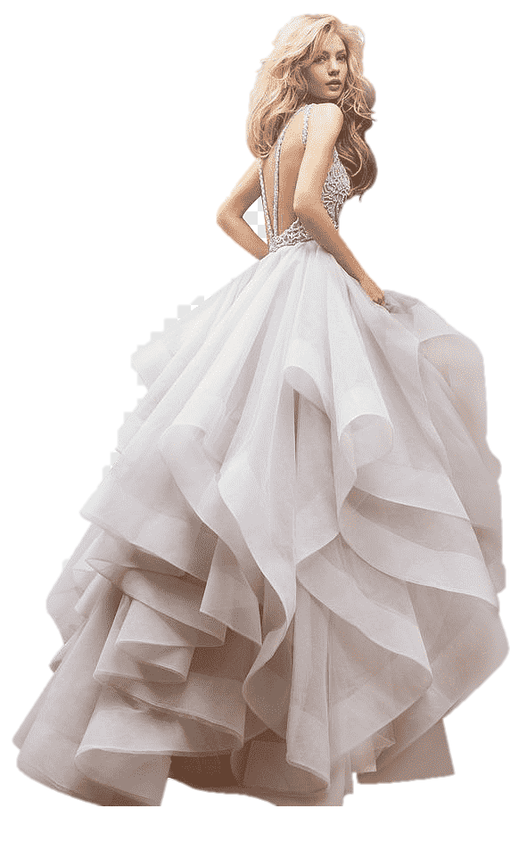
Angels do not marry
Mark 12:24 And Jesus answering said unto them, Do ye not therefore err, because ye know not the scriptures, neither the power of God?
25 For when they shall rise from the dead, they neither marry, nor are given in marriage; but are as the angels which are in heaven.

Slide 87

Female Angels?
Zechariah 5:9 Then lifted I up mine eyes, and looked, and, behold, there came out two women, and the wind in their wings; for they had wings like the wings of a stork: and they lifted up the ephah between the earth and the heaven.
10 Then said I to the angel that talked with me, Whither do these bear the ephah?
11 And he said unto me, To build it an house in the land of Shinar: and it shall be established, and set there upon her own base.

Slide 88
Angels that Sinned
Jude 6 And the angels which kept not their first estate, but left their own habitation, he hath reserved in everlasting chains under darkness unto the judgment of the great day.

Slide 89
The Fallen once use the liars
Acts 8 Simon the sorcerer
Acts 13:6,8,10
6 ... a false prophet, a Jew, whose name was Barjesus:
8 ... Elymas the sorcerer ...
10 And said, O full of all subtilty and all mischief, thou child of the devil, thou enemy of all righteousness, wilt thou not cease to pervert the right ways of the Lord?
Paul made him blind

Slide 90
The evil continues
The devil has the power of death Heb 2:14
He is as a roaring lion 1Pet5:8

Slide 91
Deceiver Angels
Even nowadays angels can deceive, and it is another question if the good angels can fall as in the time of Noah the watchers.
Galatians 1:8
But though we, or an angel from heaven, preach any other gospel unto you than that which we have preached unto you, let him be accursed.

Slide 92
Some Greek History maybe right
Revelation 9:11
And they had a king over them, which is the angel of the bottomless pit, whose name in the Hebrew tongue is Abaddon, but in the Greek tongue hath his name Apollyon. (Apollo twin brother of Artemis)

Slide 93
The book of enoch

Slide 94
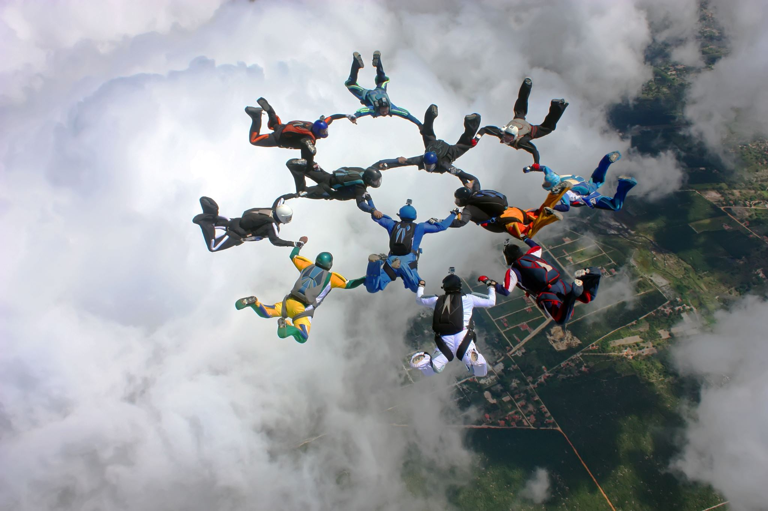
The Story of the Watchers
The Watchers were a group of 200 angels who were tasked with watching over humanity.
However, they became enamored with human women and decided to descend to Earth to take them as wives.
This act of rebellion was led by their leader, Semyaza.

Slide 95

What they taught
Once on Earth, the Watchers taught humans various forbidden knowledge and skills, such as:
Sorcery and enchantments
Astrology and the movement of celestial bodies
Weapon-making and warfare techniques
Cosmetics and the art of beautification

Slide 96
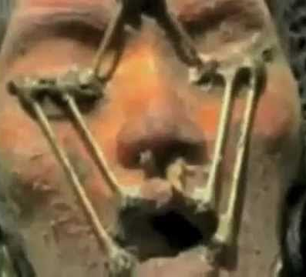
Alien Mona lisa
A pilot girl escaped from the great flood of Noah

Slide 97
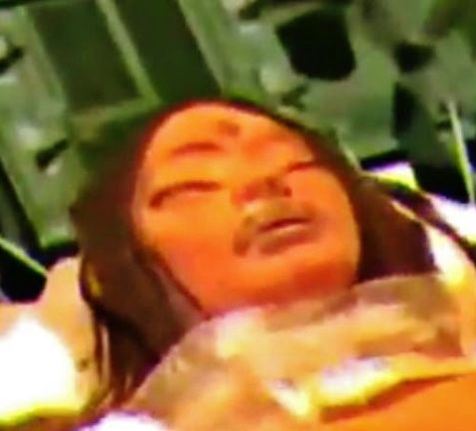
After removing devises

Slide 98
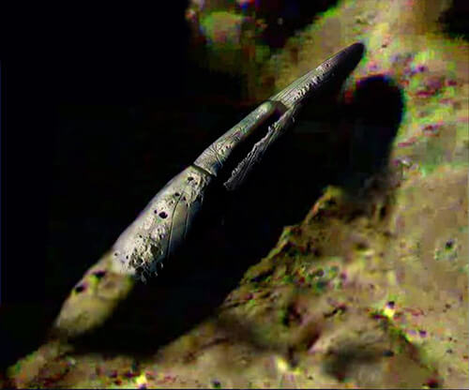
Their spaceship
3370meter long
500 meters high

Slide 99
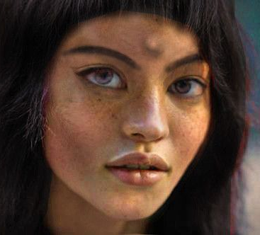
Reconstruction
It is said:
This is how she looks like today and she is alive

Slide 100
The cause
Their union with human women resulted in the birth of the Nephilim, a race of giants who caused great chaos and destruction on Earth.
The Nephilim's violent behavior and the corruption brought by the Watchers' teachings led to widespread suffering and sin among humans.

Slide 101
God intervenes: Because of corruption and devastation.
He sent the archangels Michael, Gabriel, Raphael, and Uriel to deal with the situation. They were tasked with:
Binding the Watchers:
The rebellious angels were bound and cast into the depths of the Earth, where they would remain imprisoned until the Day of Judgment.
Destroying the Nephilim:
The giants were to be destroyed to cleanse the Earth of their influence.
Purifying the Earth:
The archangels worked to restore order and purity to the world.

Slide 102
The book of Enoch
The Book of Enoch provides a detailed account of these events, highlighting the consequences of the Watchers' actions and the divine response to their rebellion. This story tells us about the dangers of disobedience and the importance of maintaining divine order.

Slide 103
offspring of the Watchers
In the Book of Enoch, God decrees a severe judgment for the offspring of the Watchers, known as the Nephilim. These giants, born from the union of the Watchers and human women, brought great chaos and corruption to the Earth. Here’s what God decided for them:

Slide 104
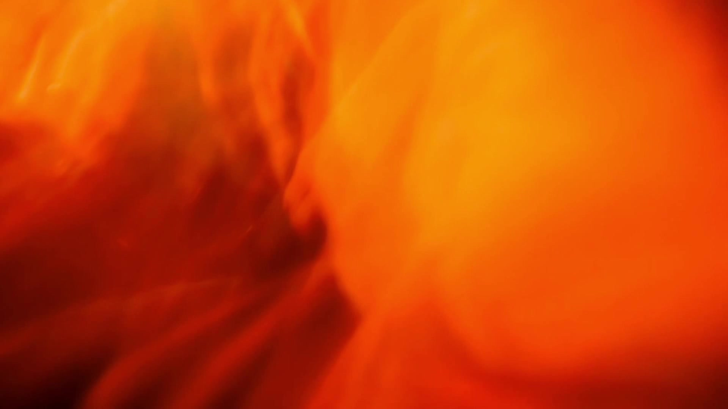
Destruction:
God commanded the archangels to destroy the Nephilim. Their violent and destructive nature had caused immense suffering, and their eradication was necessary to restore order and purity to the world.

Slide 105
Spirits of the Nephilim:
After their physical destruction, the spirits of the Nephilim were condemned to roam the Earth. These spirits, often referred to as evil spirits or demons, were to remain on Earth and cause trouble for humanity. They were not granted peace or rest, as their existence was a result of the Watchers' rebellion.

Slide 106
Judgment Day:
The spirits of the Nephilim are to face final judgment on the Day of Judgment. Until then, they continue to exist as malevolent entities, influencing and tormenting humans.

Slide 107
There are still some left over

Slide 108
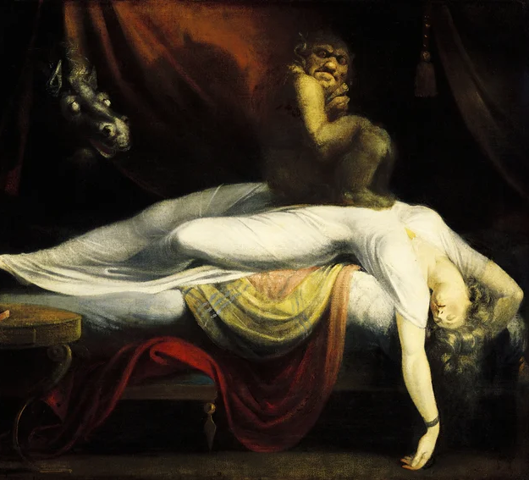
The night mare
An “Evil Spirit” that brings horror dreams to destroy the future of a human because that spirit has no future

Slide 109
To restore love and order
This judgment highlights the consequences of the Watchers' actions and serves as a warning about the dangers of disobedience and corruption.
The story underscores the importance of maintaining divine order and the severe repercussions of defying God's will.

